Slide 1
Adult Learning and COVID-19: state of play and future orientation
A REPORT FROM THE ET2020 WORKING GROUP ON ADULT LEARNING (WGAL)
Presentation Simon Broek
9 June 2020

Slide 2
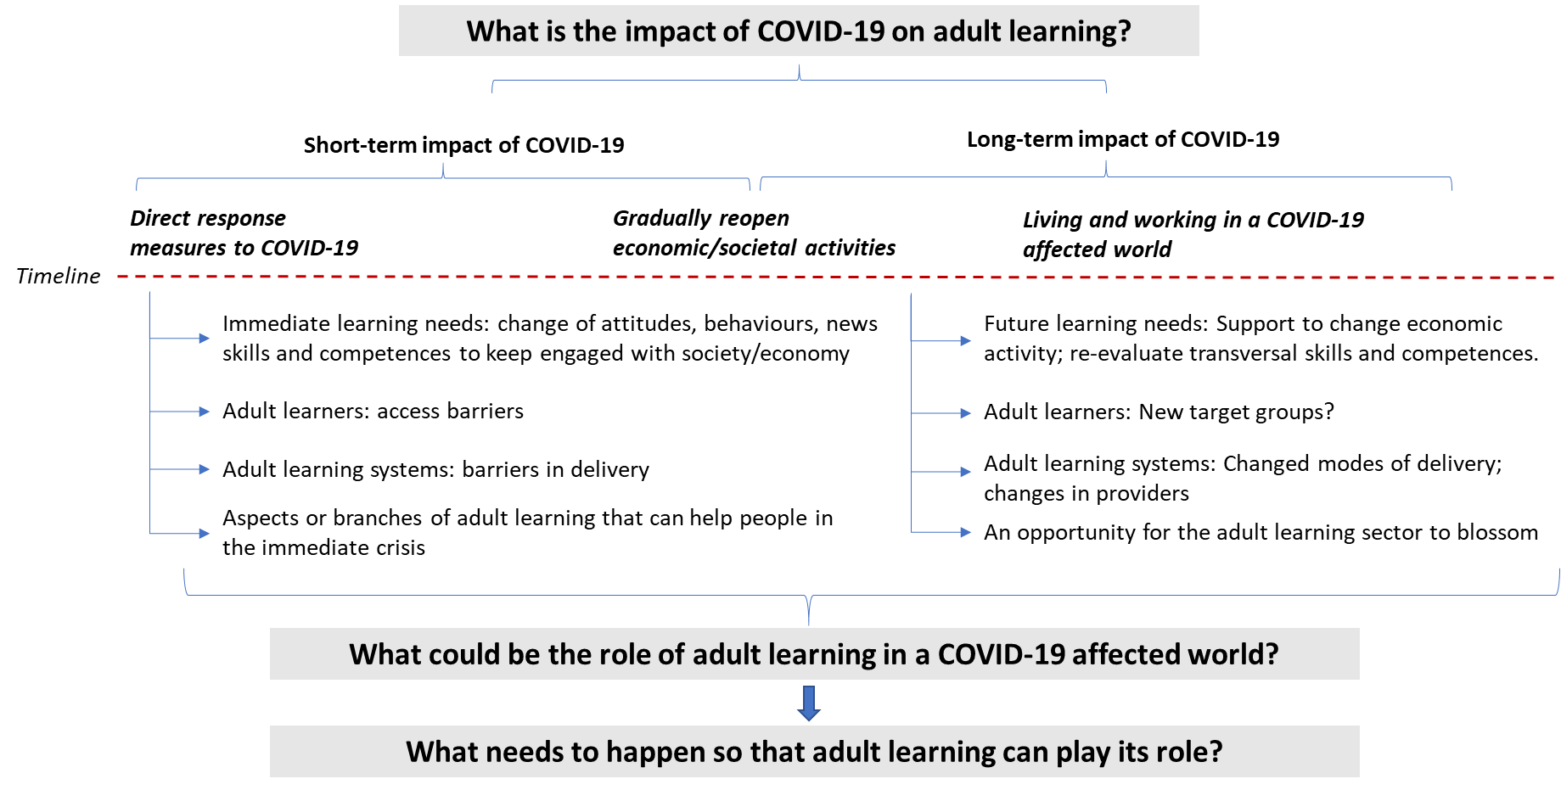
Aim of the report
Provide insights into the impacts of the COVID-19 crisis on adult learning;
Provide insights into the role adult learning can play within the context of this crisis (and future or similar crises);
Provide information and reflections regarding these aspects, to feed the discussion(s) at Member State and European level

Slide 3
Methodological approach
prepared by the ET2020 Working Group on Adult Learning
desk research (on the COVID-19 crisis, adult learning, future scenario’s, etc.)
written input from the members of the WGAL (AT, BE FR, BG, CH, CY, CZ, DE, EE, ES, FR, HR, HU, IE, IT, LU, LV, NL, NO, PT, SE, SI, and TK)
Structure of the report
1. Background and aim of the report
2. What are the effects of COVID-19? Setting the scene
3. How is the adult learning sector coping with COVID-19?
4. What is the role of adult learning in a COVID-19 affected world?
5. Conclusions and considerations

Slide 4
2. What are the effects of COVID-19? Setting the scene
COVID-19 affecting countries and their societal systems
Impacts on all areas (health care systems, economy, labour markets, ET systems, social security systems, political/governance)
Education systems (overall) are changing, rapidly, while transitioning to distant learning; even finding solutions for classes that are traditionally considered most ‘physical’ in nature
COVID-19 affecting individuals
The extent to which individuals are affected, is inherently linked to their (demographic) characteristics at the start of the crisis.
the need of individuals to adapt to the new situation in various areas of their life, brings to light an increased need for various skills (especially soft skills).
Early scenarios for the COVID-19 affected future
COVID-19 crisis will undoubtedly lead to economic recession(s) at a global scale
those at higher risks will be hit the hardest, and will have the least possibilities to overcome the challenges they face.
digital literacy (and the use of digital tools),
self-management (and self-reliance),
time-management,
flexibility (in planning, workplace, etc.),
adaptability,
resilience,
creativity and ingenuity,
collaboration, communication, and
emotional intelligence.

Slide 5
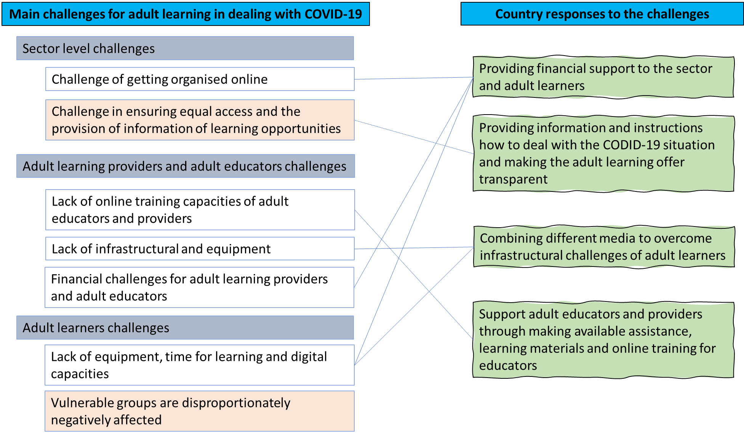
3. How is the adult learning sector coping with COVID-19?
Adult learning provision continued, be it online
The importance of basic skills; especially language, digital and critical thinking
Steep learning curve and a sense of solidarity
Immediate responses work on many of the emerging challenges
Responses do not solve the most persisting challenges

Slide 6
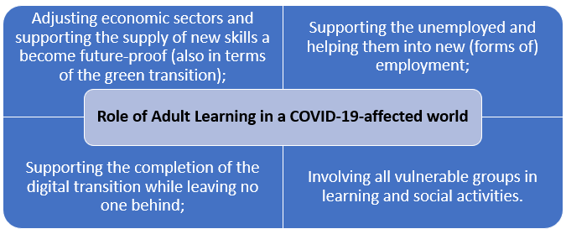
4. What is the role of adult learning in a COVID-19 affected world?
The role of adult learning
Future of adult learning delivery: online, cooperative, tailored and focusing on empowering individuals and communities

Slide 7
Conclusions on the role of adult learning in a COVID-19 affected world (1/3)
COVID-19 affected all economic sectors and the society as a whole, but affected the vulnerable groups the most.
The crisis showed the importance of basic skills (literacy and digital skills); critical thinking skills and learning to learn skills for individuals. Furthermore, they showed that individuals and communities should be able to have a minimum level of self-sufficiency.
Adult learning systems have been heavily impacted by the COVID-19 crisis (getting organised online; reaching out to adult learners; and ensuring that adult educators have the right skills and equipment). However, adult learning systems have largely managed to respond quickly and effectively to the challenges posed.

Slide 8
Conclusions on the role of adult learning in a COVID-19 affected world (2/3)
4. The immediate responses from the adult learning system show a weakness in the ability to reach those that matter the most: specific vulnerable groups. Also, on the longer term there is a need to substantially improve the quality of the online delivery.
5. In a COVID-19 affected future, adult learning systems have an important role to play in terms of
adjusting economic sectors;
supporting the unemployed;
supporting the completion of the digital transition;
involving all vulnerable groups.

Slide 9
Conclusions on the role of adult learning in a COVID-19 affected world (3/3)
6. For this however, adult learning systems need to strengthen on online learning; cooperation; tailoring and self-organising principles and empowerment.
7. All in all, effective adult learning systems are essential to secure an equal, just and inclusive recovery from the COVID-19 crisis and to facilitate the manifold transitions of people in work, social life and personal life.
This requires substantial changes of how adult learning systems are organised, coordinated, financed and how they offer their learning and reach out to vulnerable groups.

Slide 10
Considerations on what is needed for adult learning to fulfil its essential role (1/2)
Consideration 1: At national level, it can be considered to develop a national adult learning sector-wide strategy.
This to better position adult learning and to make it future-proof and able to support the society and economy to function in a COVID-19 affected future.
This sector-wide approach should ensure cooperation; secure effective skills intelligence; tailor to needs; and reach out to all.

Slide 11
Considerations on what is needed for adult learning to fulfil its essential role (2/2)
Consideration 2: At the European level, a new action plan could be drafted as a follow up of the renewed European agenda for adult learning (EAAL).
It is important that at European level such a plan is developed to encourage Member States to continue working on adult learning.
it emphasises the importance of the sector to ensure equal and inclusive societies and labour markets and to ensure innovation and competitiveness of the economies.
As in adult learning, also at European level, the countries being hit hard the most, also have most challenges to overcome the crisis and hence need for a quality adult learning system. The crisis therefore asks for a European level response and European level solidarity, at least when it comes to find common responses and learn lessons from countries’ experiences.

